Slide 1

ELDHOSE VARGHESE
MCA
Notes:
Lecture by Rasha Tarawneh, Omamah Thunibat and Dr. Ahmad B. A. Hassanat

Slide 2

Abstract
Modules
Topic-Description
Existing System
Proposed System
Table Design
Diagrames
Forms

Slide 3

Automated ER Diagram Maker is an attempt to make a fully automated Entity Relationship Diagram
It acts as a challenge over the famous existing systems such as smart draw.
The concept behind the system development is that to avoid the practical inconvenience during the development of ER diagrams

Slide 4

1. Registration
User Registration
2. Capture
Entities
Relationship
Attributes
3. Analysis
Entered data
4. Representation
ER Diagram

Slide 5
Registration
The admin have most privilege in the registration process. Only the admin can control the registration of users.

Slide 6
Capture
In the capture process all the information that has to be represented in the diagram is capturing.
For this purpose there are several forms are designed. The user can enter data that has to be displayed in the diagram.

Slide 7
Analysis
The analysis is the process in which the accuracy is tested and appropriate design process will be in progress in this stage.
The final diagram will be produced only if the entered data is accurate.
If the entered data is accurate then the system will move on to the next process named representation.

Slide 8
Representation
In the final process named representation the diagram is represented on the screen which can be used for the further development.
So the desired final output will be represented in the screen by the end of the process named representation.

Slide 9

The project named as “Automated ER Diagram Maker” deals with the designing of automated ER diagrams.
This software will overcome all the disadvantages of the existing system.
This project deals with four processes named Registration, Capture, Analysis and Representations.

Slide 10

Eliminate the limitations of the existing system
Automate the manual activities.
User friendly and interactive.
ance.

Slide 11
The automation of the proposed system should result in:
Record maintain
The proposed system is should be capable of processing large amount of data in a quickly and efficient manner, store the data and gave the accurate results. It has to provide quality reports to the concerned department.

Slide 12

The manual system is backed by several numbers of disadvantages.
Number of error and frauds will be more. There will be more wastage of energy and time.
By making this into computerized we can maintain high accuracy and reliability

Slide 13

Limitations in diagram generation.
Excess manpower is wasted.
More time needed.
Chance of errors.
Difficulty in correcting errors.

Slide 14

This system studies the problems existing in the manual functioning and tries to resolve them by the computerization of the apartment management.
Proposed system is an interactive system, highly user-friendly, and designed exclusively for apartment management.

Slide 15

The proposed system simplifies the task of storage of data and diagram generation.
This system is fully computerized thus making it user friendlier and is more efficient, reliable, fast and accurate.
Speed in processing
Reduce manpower

Slide 16

:- ASP.NET
A popular option available to web application developers today is Active Server Pages (ASP) is a server- side-scripting environment.
Developed by Microsoft, ASP is a technology that provides a web server
visual Studio 2010
GiTHub

Slide 17

Table 1
Table name - Attribute
Field Name | Data type | Description | Constraints
Attribute_id | Int | Attribute_id | Primary key
AttributeName | varchar(50) | AttributeName | Not null
Entity_id | Int | Entity_id | Foreign key

Slide 18
Table 2
Table name- Derived Attribute
Field Name | Data type | Description | Constraints
DerivedAttribute_id | Int | DerivedAttribute_id | Primary key
DerivedAttributeName | varchar(50) | DerivedAttributeName | Not null
Entity_id | Int | Entity_id | Foreign key

Slide 19
Table 3
Table name - Entity
Field Name | Data type | Description | Constraints
Entity_id | Int | Entity_id | Primary key
EntityName | varchar(50) | EntityName | Not null
User_id | Int | User_id | Foreign key

Slide 20
Table 4
Table name - Login
Field Name | Data type | Description | Constraints
User_id | Int | User_id | Primary key
UserName | varchar(50) | UserName | Not null
Password | Int | Password | Not null

Slide 21
Table 5
Table Name – Multi Valued attribute
Field Name | Data type | Description | Constraints
MultyValuedAttribute_id | Int | MultyValuedAttribute_id | Primary key
MultyValuedAttributeName | varchar(50) | MultyValuedAttributeName | Not null
Entity_id | Int | Entity_id | Foreign key

Slide 22
Table 6
Table name- Relation
Field Name | Data type | Description | Constraints
Relation_id | Int | Relation_id | Primary key
RelationName | varchar(50) | RelationName | Not null
Entity_id | Int | Entity_id | Foreign key

Slide 23
Table 7
Table name - Registration
Field Name | Data type | Description | Constraints
User_id | Int | User_id | Primary key
Name | varchar(50) | Name | Not null
Address | Varchar(250) | Address | Not null
Email | Varchar(250) | Email | Not null
ContactNo | Varchar(15) | Contact Number | Not null
BankName | Varchar(250) | Bank Name | Not null
AccountNumber | Varchar(15) | Accout Number | Not null
AdarNumber | Varchar(15) | Adar Number | Not null
User Name | Varchar(15) | User Name | Not null
Password | Varchar(15) | Password | Not null

Slide 24

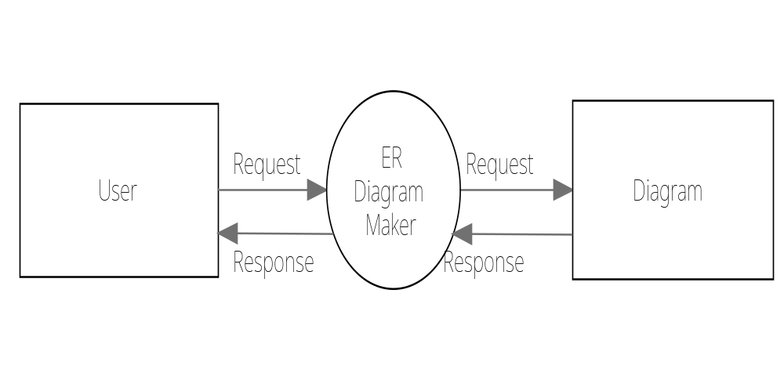
CONTEXT LEVEL (Level-0)

Slide 25

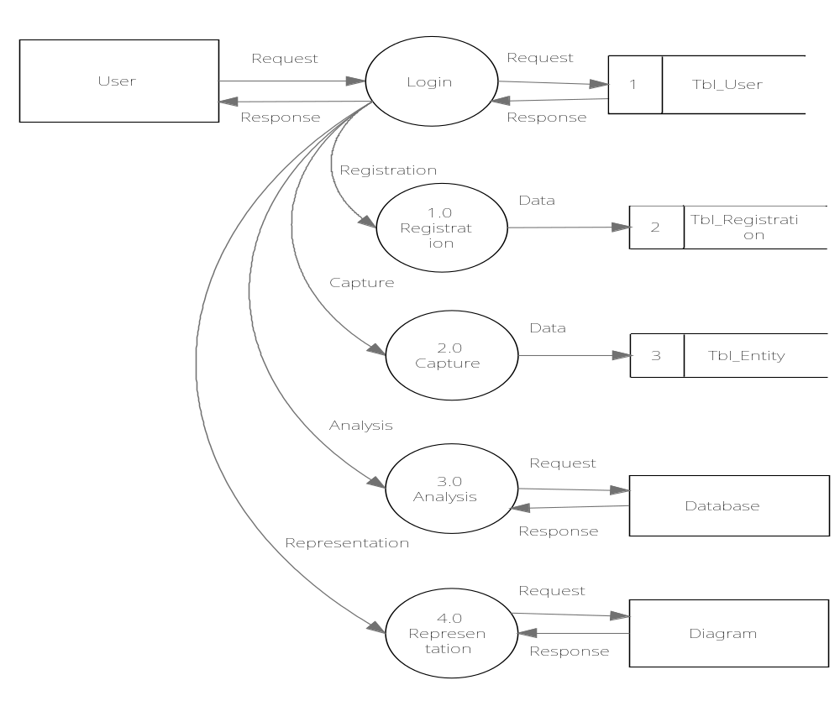

Slide 26

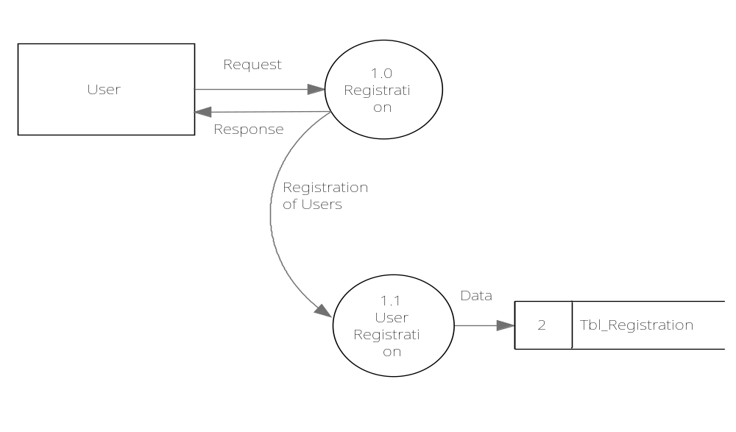

Slide 27

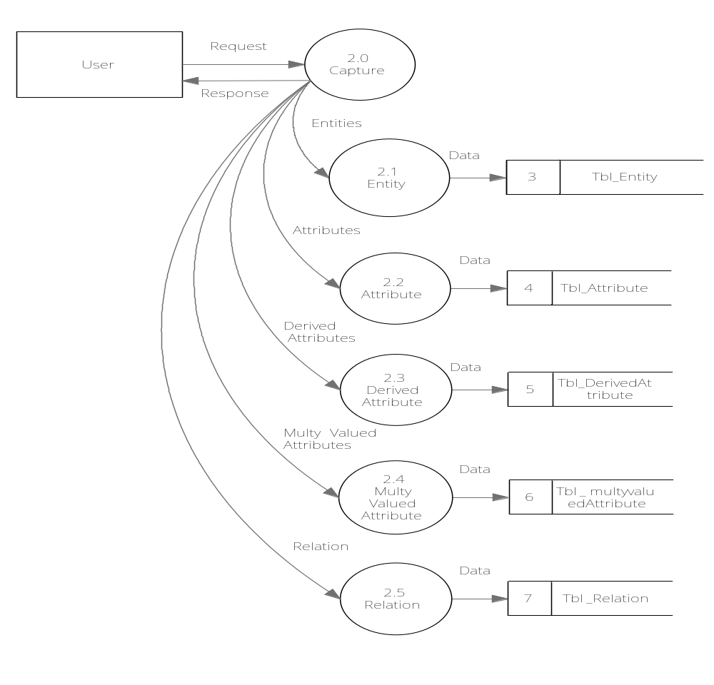

Slide 28

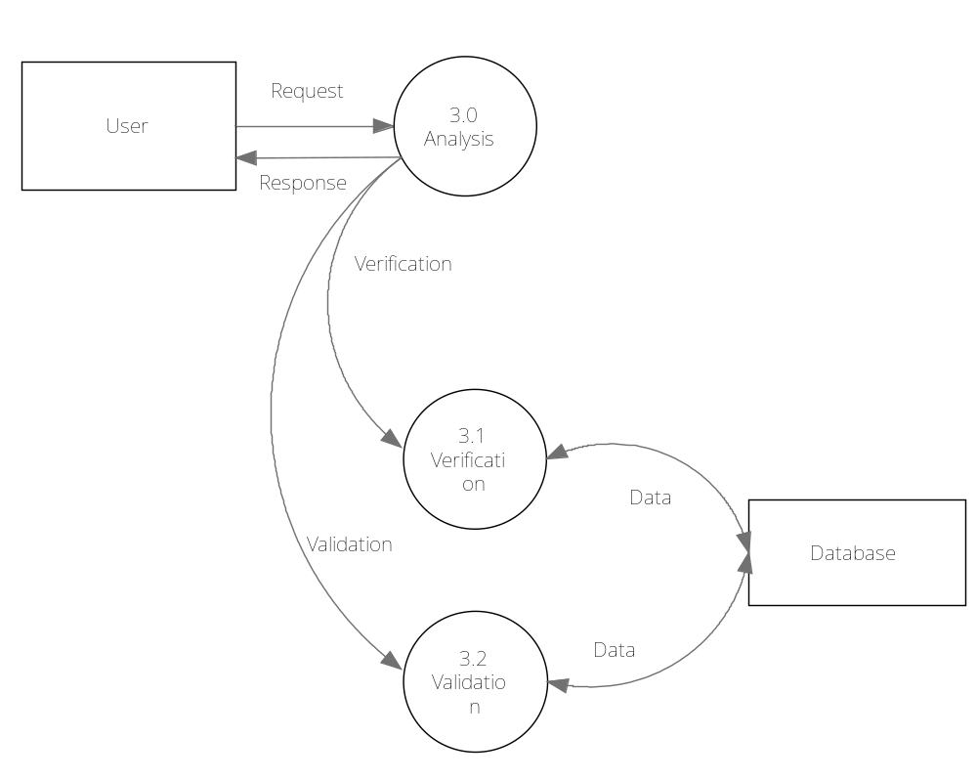

Slide 29

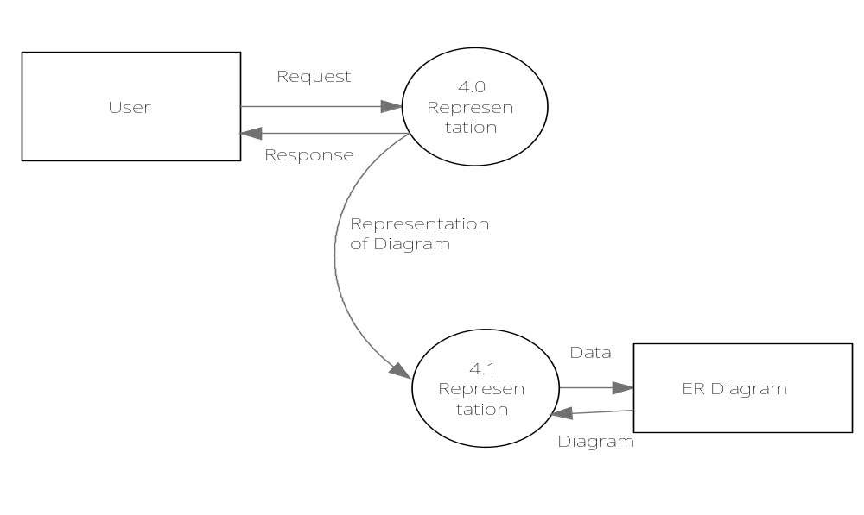

Slide 30

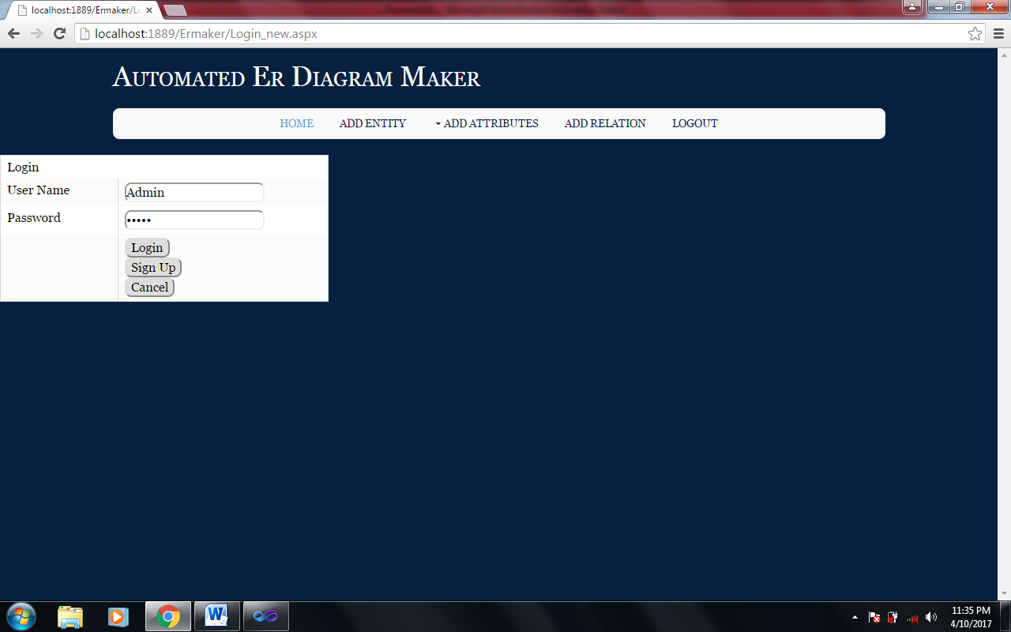

Slide 31

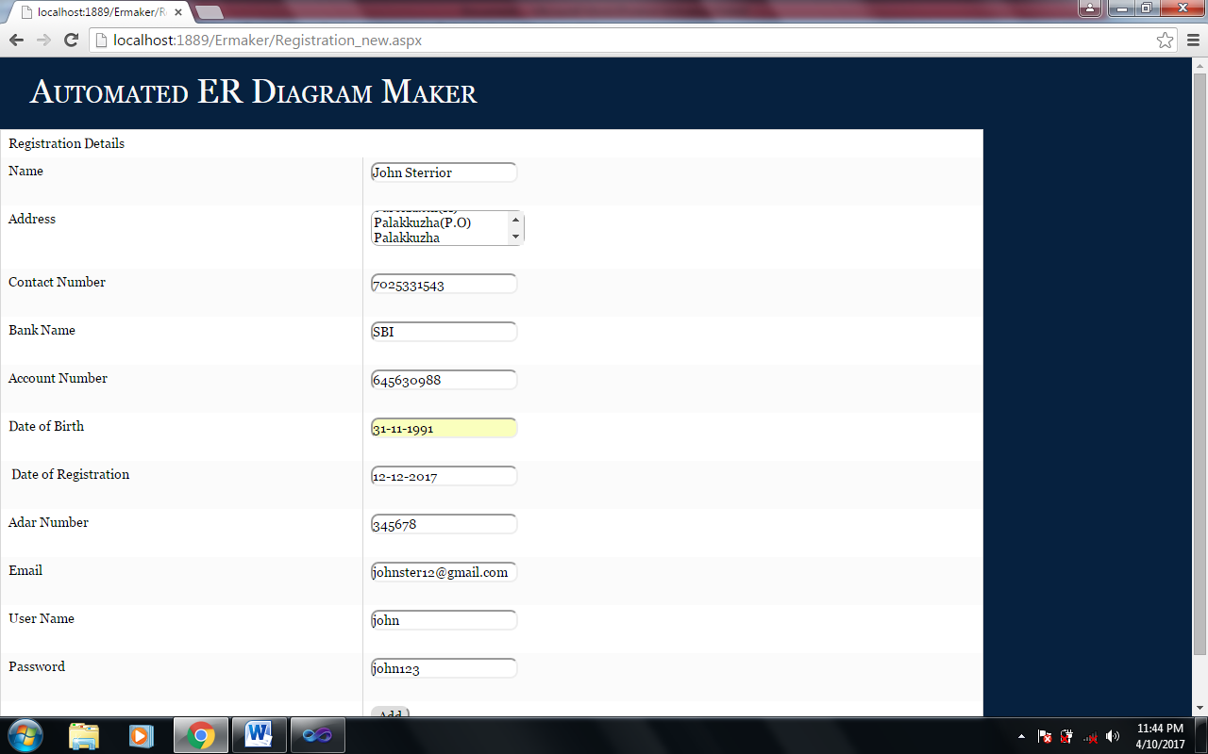

Slide 32

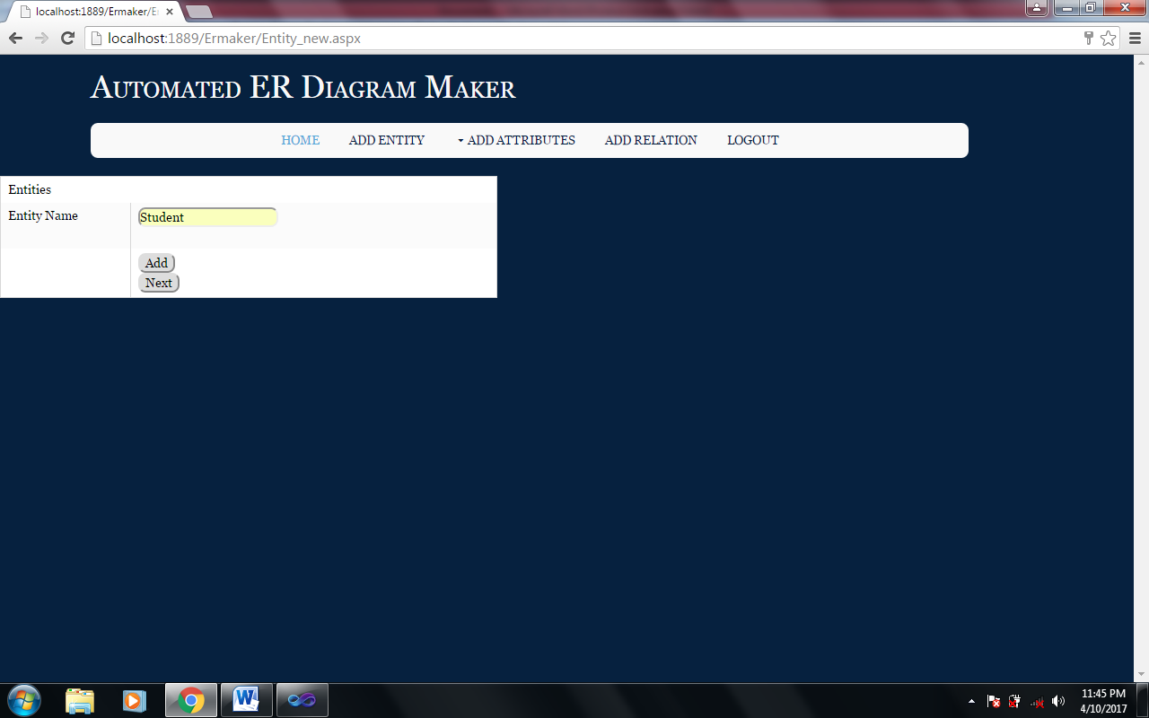

Slide 33

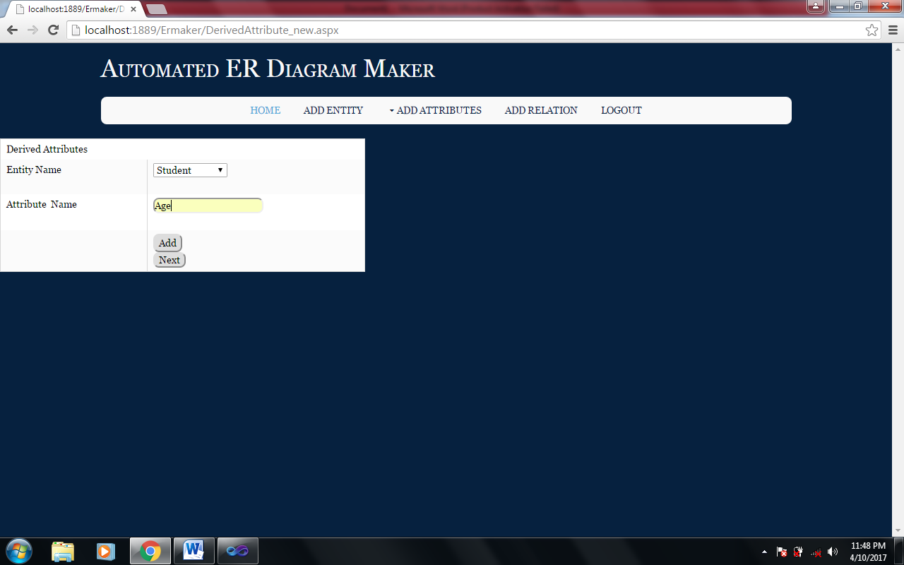

Slide 34

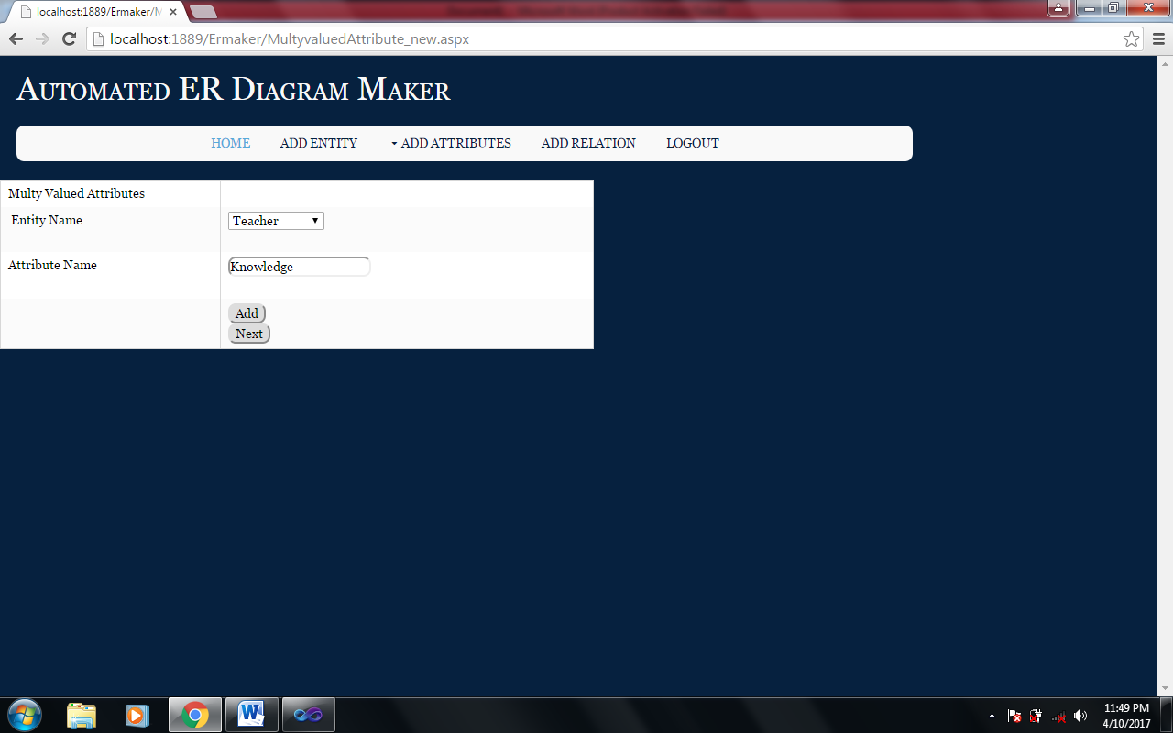

Slide 35

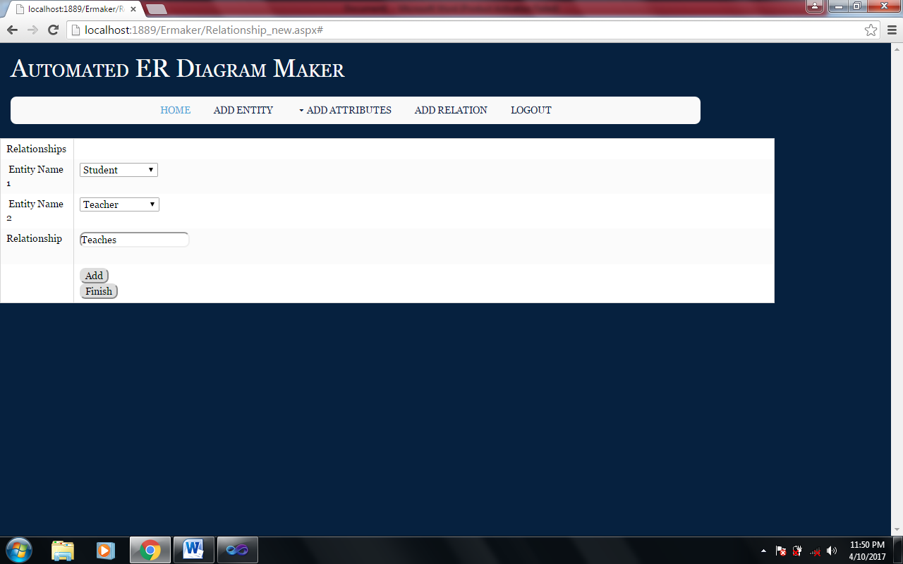

Slide 36

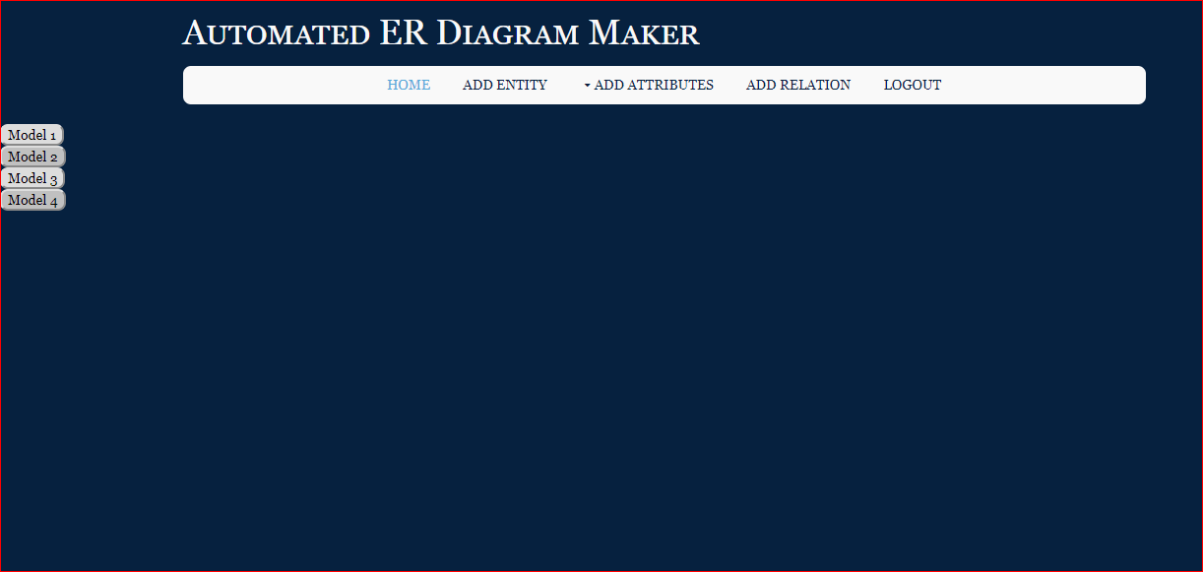

Slide 37

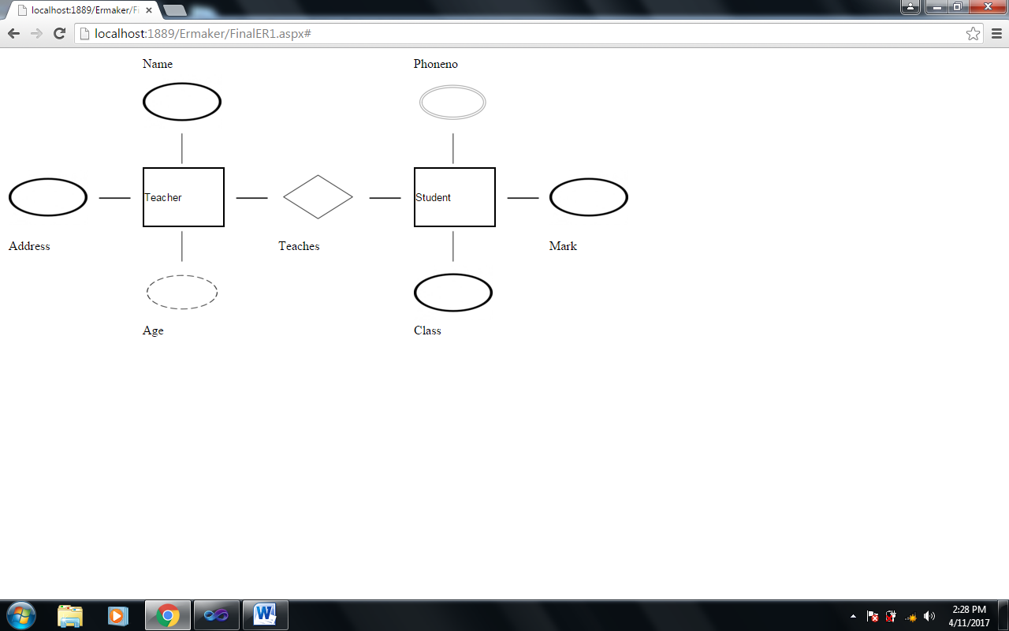

Slide 38

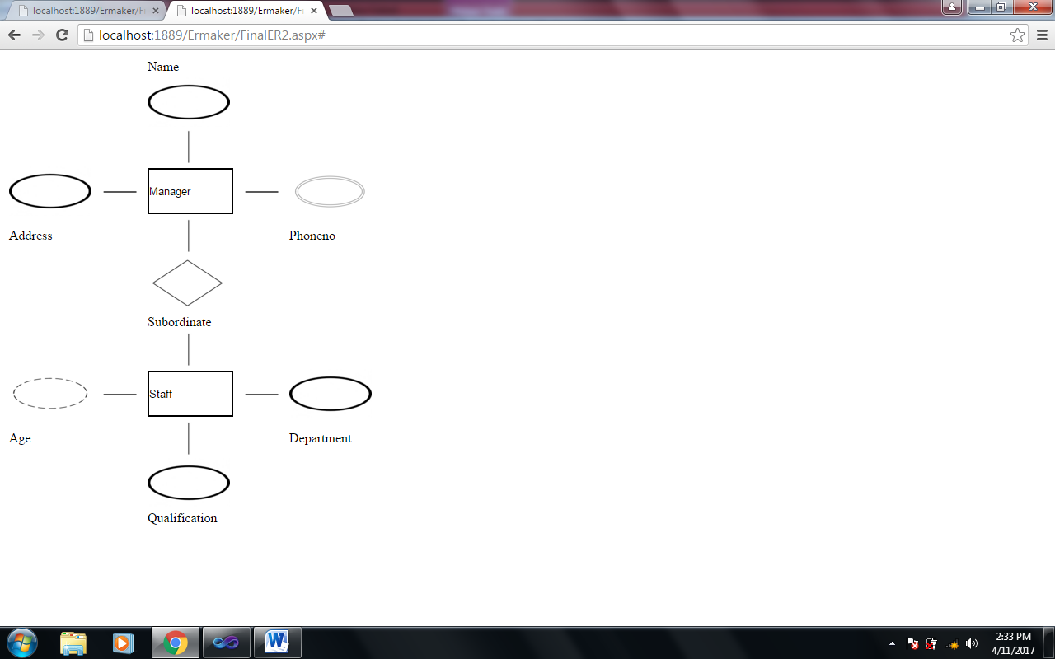

Slide 39

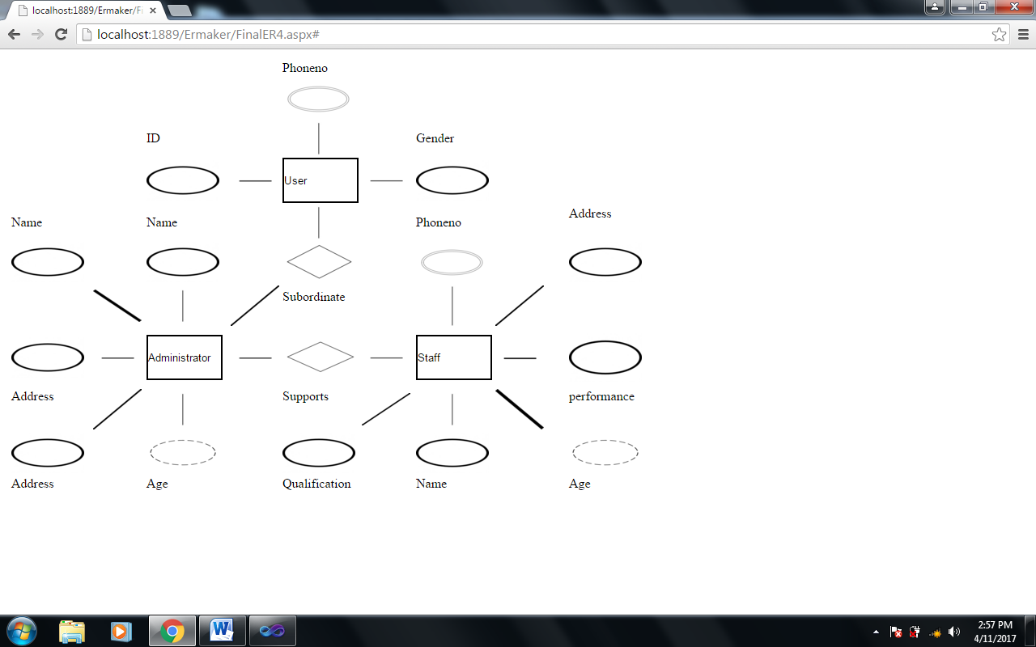

Slide 40

The project entitled “Automated ER Diagram Maker” is more helpful and has advantages over the existing system. The entire system is menu assisted and highly interactive.
In this system, neat formatted reports can be printed within a short period of time. The system is very user friendly and reports are screen oriented. Accurate updating

Slide 41

“PRO ASP.NET 2.0 WEBSITE PROGRAMMING”-
by Damon Armstrong
“SYSTEM ANALYSIS AND DESIGN”- by Elias M Award,
Second Edition, 1999, Galgotia Publications, Delhi
“DATABASE SYSTEM CONCEPTS”- by Silberschatz, Korth,Sudarshan, Fourth Edition

